Slide 1
Employee Data Analysis using Excel
STUDENT NAME:D.SHRUTHI
REGISTER NO:312217059(asunm1659312217059)
DEPARTMENT: B.COM GENERAL
COLLEGE: SHRI KRISHNASWAMY COLLEGE FOR WOMEN

Slide 2
PROJECT TITLE
VISUALISING EMPLOYEE ATTENDANCE TRENDS WITH EXCEL CHARTS

Slide 3


AGENDA
Problem Statement
Project Overview
End Users
Our Solution and Proposition
Dataset Description
Modelling Approach
Results and Discussion
Conclusion
3/21/2024 Annual Review

Slide 4

PROBLEM STATEMENT
Collect Data: Gather information on when employees check in and out, who is absent, and why. Create Charts: Use Excel to make visual charts, such as: Line charts showing daily or monthly attendance. Bar charts comparing different departments.

Slide 5

PROJECT OVERVIEW
The project aims to transform raw employee attendance data into clear, visual insights using Excel charts. These visuals will help the management team quickly identify trends, patterns, and potential issues in employee attendance, leading to better decision-making and improved workforce management.
Key Activities: 1.Data Collection 2.Data preparation 3.chart creation 4.Analysis 5.Reporting

Slide 6

WHO ARE THE END USERS?
The end users of visualizing employee attendance trends with Excel charts are: 1.Managers and Supervisors 2.HR Department 3.Executives and Leadership 4.Employees

Slide 7

OUR SOLUTION AND ITS VALUE PROPOSITION
Our Solution: We help turn employee attendance data into easy-to-read charts using Excel. These charts show trends like who’s often late, which days have more absences, and how different teams compare. Value Proposition: Better Decisions: Our charts help managers and HR quickly see attendance trends, so they can make smart decisions to improve employee management. Saves Time: Instead of digging through data, our charts make it easy to spot patterns, saving time and making it easier to take action.

Slide 8
Dataset Description
Our dataset includes the following key information about employee attendance: Employee ID: A unique identifier for each employee, helping to track individual attendance records. Employee Name: The name of each employee, providing a clear reference to the attendance data. Date: The specific day the attendance is recorded, allowing us to track trends over time. Check-In Time: The time each employee arrives at work, used to monitor punctuality. Check-Out Time: The time each employee leaves work, used to ensure full work hours are met.

Slide 9

THE "WOW" IN OUR SOLUTION
Instant Clarity: Our Excel charts make complex attendance data instantly understandable, so managers can see important trends at a glance. Actionable Insights: The charts don’t just show data—they highlight key patterns, like frequent lateness or high absenteeism, making it easy to take immediate action No Extra Costs: We use Excel, a tool most companies already have, to create powerful visualizations without the need for expensive software. Quick Setup: Our solution is easy to implement and doesn’t require any special skills. You can start visualizing trends in no time.
3/21/2024 Annual Review
9

Slide 10
MODELLING
To visualize employee attendance trends in Excel, you can use various charts that make it easy to spot patterns, such as daily attendance, absence trends, or even punctuality. Here’s a step-by-step guide to creating a simple and effective chart: 1. Prepare Your Data 2. Choose the right chart 3. Create the chart 4. Analyze the trends
10

Slide 11
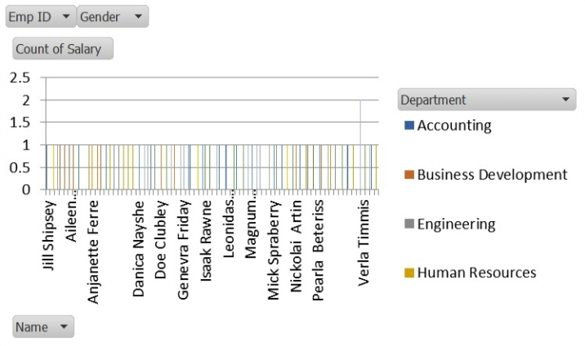
RESULTS
11

Slide 12
conclusion
In summary, visualizing employee attendance trends with Excel charts helps you easily track and understand attendance patterns. By using charts like line graphs, bar graphs, or pie charts, you can quickly see trends, compare data, and make informed decisions to improve attendance management. Regular updates and clear labeling ensure your charts provide valuable insights.

